Slide 1

Projet final
Web Application programming

Slide 2
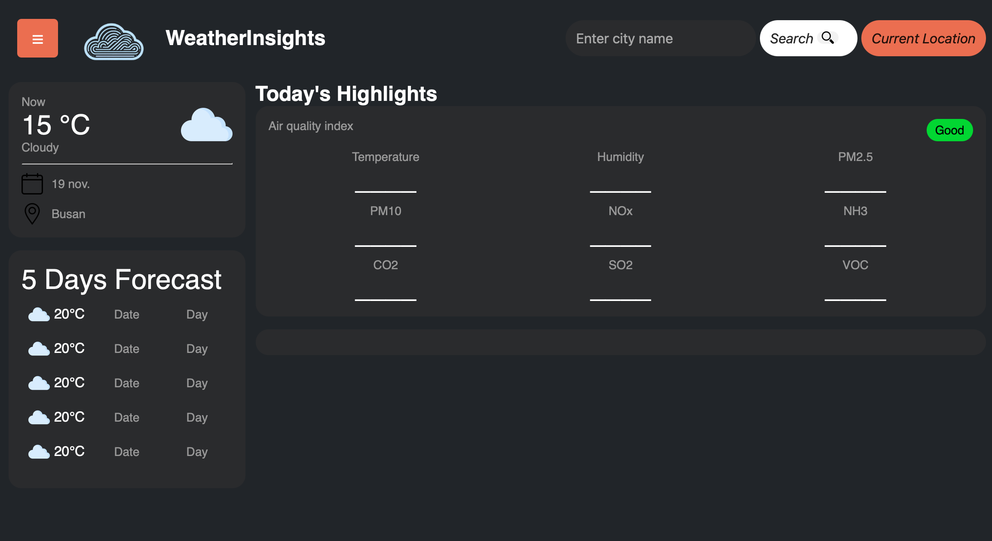
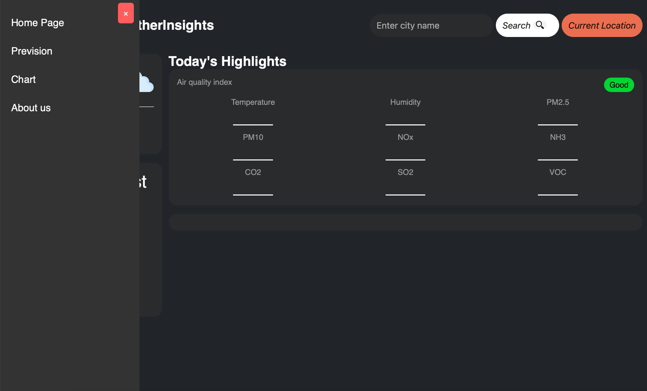
Now
Seach bar with button
Current Location button
Sidebar with menu
Front end devellopement

Slide 3
What remains to do
End of the front end development
API
Different feetures (current location, search…)

